Slide 2
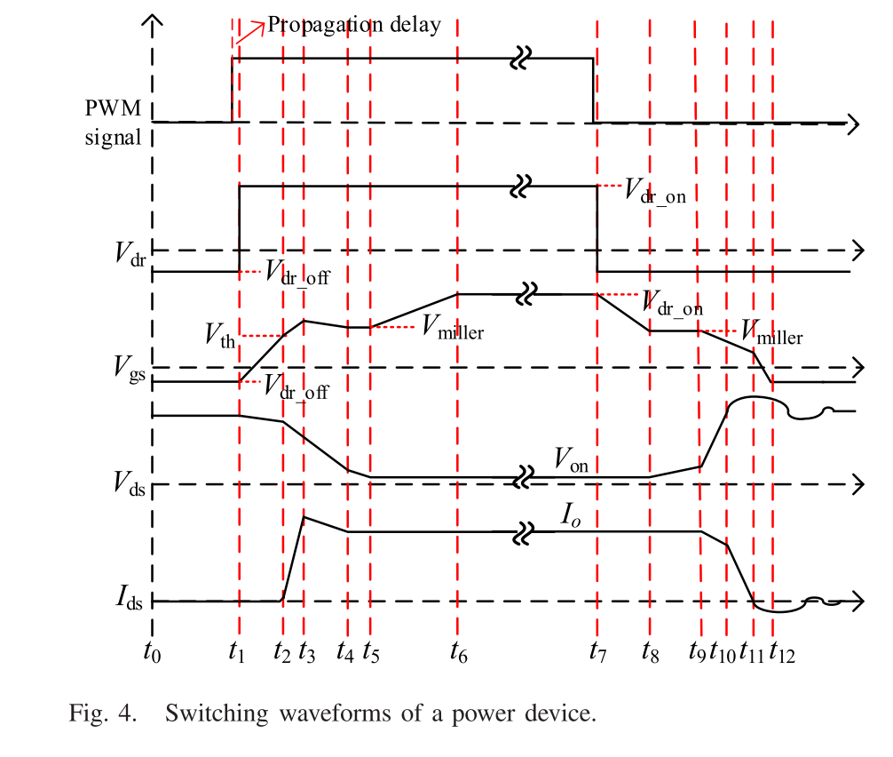
t3
t2
t4
t3
Vertical Offset
t1
t4
Current measurement delay:15.5423- 15.4933 =0.049$μs$
Voltage measurement delay:15.6543- 15.7323 =-0.078$μs$

Slide 3
Without deskewing
With deskewing

